Slide 1
Details of OQC pickup sample & chop stamp
1
Details current procedure from PCS → FA → OQC → SCM
OQC pick up & Return sample
PCS issue Pro plan
Production plan
Pick up sample
Reading barcode Inner/Outer 1st
Weight check 1st
OQC Normal inspection
Reading barcode Product / Inner
Weight check 2nd
Reading barcode Inner/Outer 2nd
Return to Pallet
①
②
③
④
⑤
⑦
⑧
⑨
⑩
SCM shortage
FA confirm stock
Reliability
inspection
⑥
OQC chop stamp
Daily Report
Chop stamp physical all lots
Find all lots same model, shift, Line
Record Pallet ID & S/N carton
Matching Pallet ID & Outer carton box
Find Pallet ID&F/G
⑯
⑮
⑭
⑬
⑫
⑪
FA/SCM
Jupiter
FA
warehouse
FA create
ID pallet
Scan ID pallet to receive by PDA
Confirm receiving by WMS
(21)
⑰
⑱
⑲
⑳
Shipment
(22)
Current situation:
Pickup & Return sample → Manual Job at process: ① ~ ⑦
Chop stamp: Loss time to find pallet → Manual Job at process: ⑪ ~ ⑯
Need to improve

Slide 2
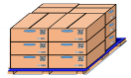









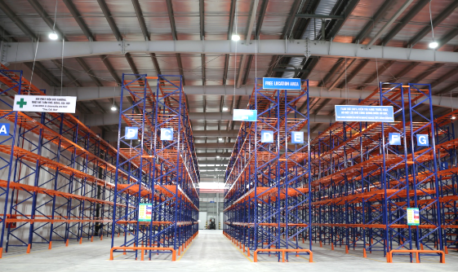
OQC Visualize System
1
4
Flow chart from OQC → FA → SCM → Jupiter
Note:
Pallets that OQC not pickup sample → Can be transferred to SCM warehouse but are still in checking status on OQC system
SCM need to control product under “Checking status” for ensure not ship out to Market
These pallets can be transferred to Jupiter & Jupiter must be linked to OQC system to know whether product status is OK or not
OQC return sample
FA
fix location
E-map
SCM
out location
SCM Warehouse
Ship to
Market
①
SCM confirm FG
status by OQC system
②
OQC Inspection
Jupiter confirm FG status by OQC system
Jupiter warehouse

Slide 3
E-map at FA warehouse
FA
17
FA warehouse (Waiting Pallet ID)
OK product
10 Pallets
10 Pallets
10 Pallets
10 Pallets
FA warehouse
Waiting AQ2/NG FG)
5
Pallets
5
Pallets

Slide 4
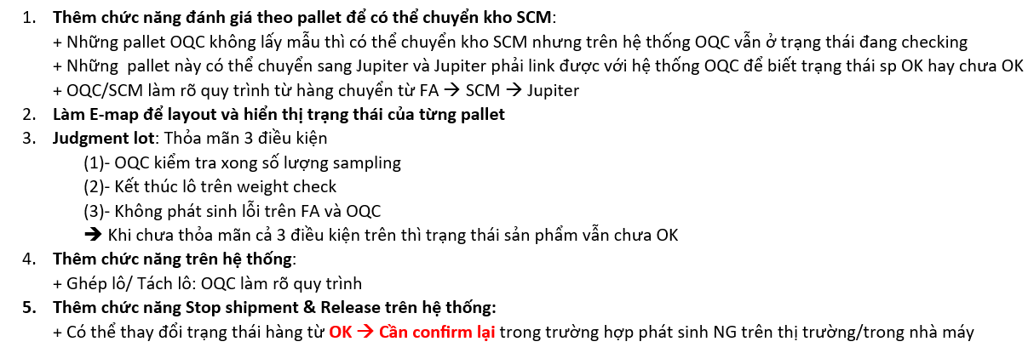
E-map at FA warehouse
17
Nội dung công việc:

Slide 5
Rule to Judge 1 LOT
2
Identify 1 lot:
There is another model to insert running while current model is running ➔ Switching model time is counted a new lot (Lot: Change another model or finish working shift)
If during FA running, happen NG nếu cần thiết thì OQC sẽ chia lot
Trong trường hợp OQC muốn gộp lô thì sẽ áp dụng tiêu chuẩn lô kết hợp (Lô kết hợp được tính trong trường hợp 1 model sản xuất liên tục của các ngày liền kề (thông thường là 1 tuần) và chất lượng phải ổn định)
Judgment 1 lot:
OQC will judge lot after finish inspection all sample Q'ty regardless of whether production has ended ➔ Condition: OQC finish sample Q’ty + FA finish production + FA/OQC no happen NG
(Including Characteristic, Specification, Reliability sampling finished)
1st sample
2nd sample
……
N sample
Final Judgment for Lot
OK
OK
OK
OK

Slide 6
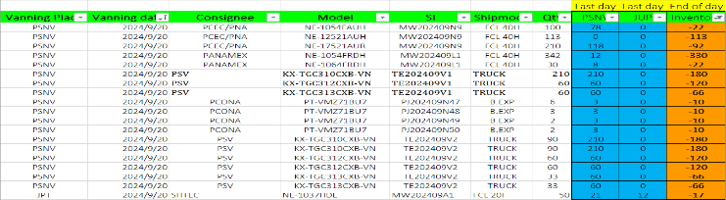
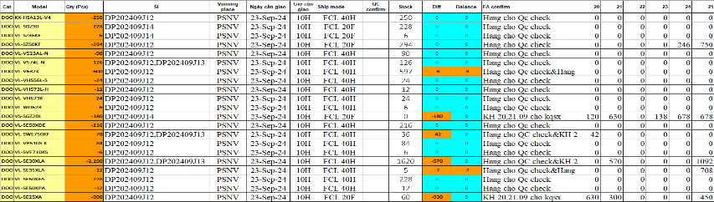
① Confirm shortage shipment
3
OQC confirm shipment plan to focus priority shipment models by manual
◆ Current
◆ Proposal
Step 1: SCM send inventory & shipment plan
Request system will be displayed details:
Indicate priority shipment model to announce OQC pick up inspection
Indicate details: Ship by Board/Air, Stock Q'ty, shipment Q’ty, Minus product compare vs shipment plan
Minus product: Q’ty, Reason, when re-running (need indicate)
In case production plan be changed → Auto refresh
Classify type of product and display : EMC, PP, PMP and can shipment or not (Ex: PP cannot shipment..)
Step 2: FA update inventory & shipment plan
IT confirm: Hưng Đạo sẽ trả lời về lấy dữ liệu hàng thiếu (SCM xác nhận tiếp)
Step 3: OQC input shipment info to focus check priority
Using time: 5 mins/day*4 BD/BU =20 mins/day
Save time: 20 mins/day

Slide 7
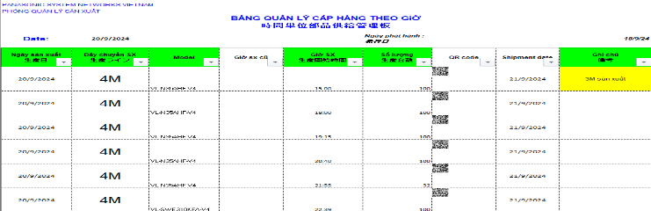
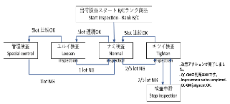
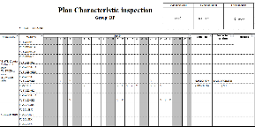
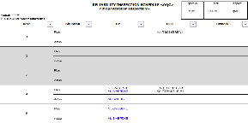
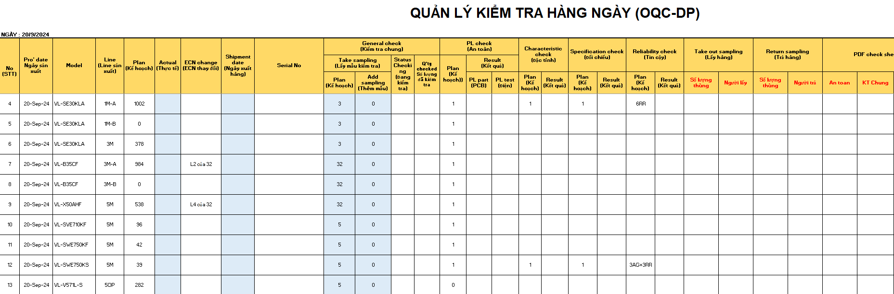
① OQC re-make production plan
4
OQC re-making production plan base on production plan that PCS send
◆ Current
◆ Proposal
Step 1: PCS send Daily production plan <Email/Server>
OQC make database: Sample Q’ty; Reliability plan
Q’ty sample Standard
Plan
Plan
System will be linked with OQC Inspection plan:
OQC sampling Q’ty (Incase if happen Quality issue, sample Q’ty level will be changed → Return to previous level → OQC make Data base)
Add : 1 column for adjust sample if need to follow up quality issue
Auto assign model that should be Reliability test
Auto change sample Q’ty level (Ex: Normal level → Loosen level)
If cannot catch up plan → Can adjust and display reason (Only OQC member can revise)
Indicate minus product in OQC control sheet
Step 2: OQC copy into OQC format to control
OQC re-making production base on information of PCS:
Add some information: Sample Q’ty, PL, Characteristic, Reliability, Specification…
➔ Using time: 10 mins/day
System will link with OQC inspection plan and auto update:
➔ Save time: 10 mins/day

Slide 8
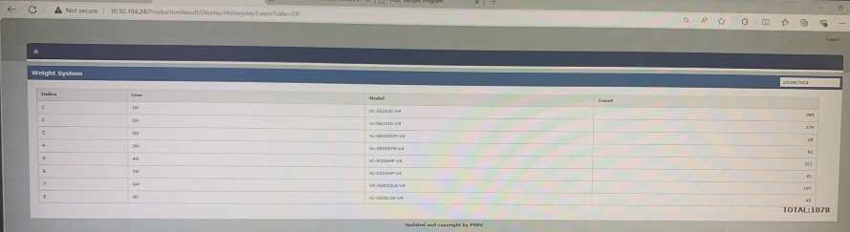
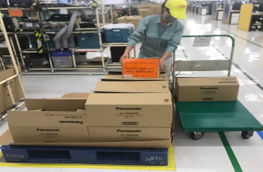
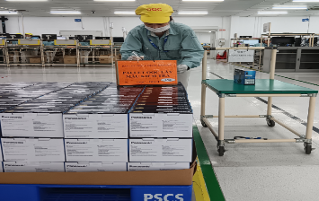
② OQC pick up sample
5
OQC pick up sample follow serial range
◆ Current
◆ Proposal
Step 1: Access PSNV Portal to confirm Production result
System can be indicated:
Scan barcode of Outer box → Displays Outer box OQC pick up: FA easy to control sample quantity OQC pick up (FA easy to inventory Q’ty)
System will remind OQC to pick up sample
Indicate time OQC pick up sample on system
Indicate pallet OQC pick up sample to eliminate finding and scan barcode many times
Step 2: Divide serial range to pick up sample at Pallet
DP
DECT
Pick up outer box & put indication
Pick up inner box & put indication
Using time: 1mins*8 times/day=8 mins/day
Save: 8 mins/day

Slide 9
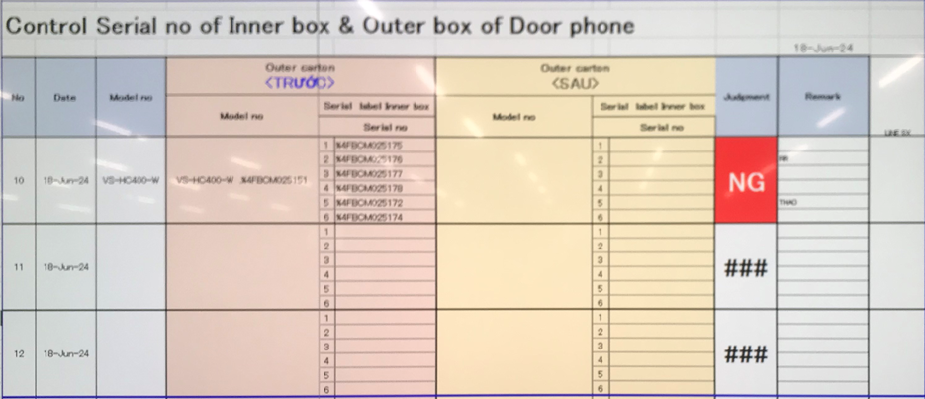
③ Reading barcode Inner/Outer 1st time
6
Confirm Outer carton and inner box
◆ Current
◆ Proposal
Reading Barcode of Outer box and Inner box
System link weight check system to confirm Outer box includes which inner boxes
Purpose: To confirm Outer box includes how many inner box and which serial No
Using result of FA weight check system → Eliminate operation at OQC
Using time: 30lots*10sec*2Outer boxes=10mins/day
Save: 10 mins/day

Slide 10
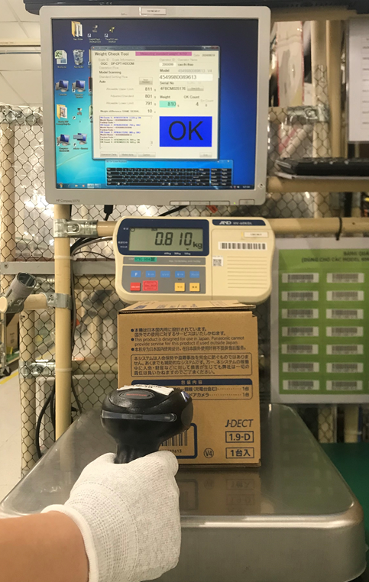
④ Weight check 1st time
7
Weight check offline at OQC to confirm accessory
◆ Current
◆ Proposal
Weight check 1st time (Control offline):
System link weight check system to weight of inner box
Purpose: To confirm full inner box before un-packing
FA already applied weight check system: No need add this point ➔ Eliminate weight check 1st at OQC
Using time: 150pcs*5sec*2 BD/BU=24mins/day
Save: 24 mins/day

Slide 11
⑤ OQC Normal inspection
8
OQC normal inspection
◆ Current
◆ Proposal
Current inspection procedure
System link with Database sample Q’ty:
OQC scan barcode serial No of product → Auto link with OQC checksheet
After OQC finish inspection → System indicate result of each serial No (In case NG will be indicated NG situation and reason NG)
System auto confirm matching sample Q’ty with database to indicate changing situation
+ System alarm if inspect duplicated serial No
+ Save history of sample check → Can Traceability
Incase FA happen quality issue → Alarm on system (Prevent OQC judgment OK when FA happen NG) → How to return product of this lot?
Confirm the number of samples to be taken
Appearance check
Function check
Manual confirm sample Q’ty enough or not

Slide 12
⑥ Reliability inspection
9
Reliability inspection:
◆ Current
◆ Proposal
Current inspection procedure
System link with Database sample Q’ty:
OQC make Database about grouping series model need to check Characteristic, Reliability (Monthly)
System auto select model and remind to inspect:
+ Limit Q’ty of model to be suitable with OQC lead time
(Ex: OQC can check maximum 2pcs characteristic)
+ System default: After Reliability test → Normal inspection.
In case sample not yet checked normal → Will be alarm and
cannot judgment lot
+ In case happen Quality issue will be displayed NG situation
and after rework/repair → Change situation (Have history:
Main cause, action)
+ If model only produced 1 time in a month → Need to
indicate in inspection plan to remind OQC pick up
Confirm checking plan of characteristic, specification, reliability
Basic function check: Power ON check
Inspect: Characteristic, Specification, Reliability
Full function check
Indicate result in OQC control sheet

Slide 13
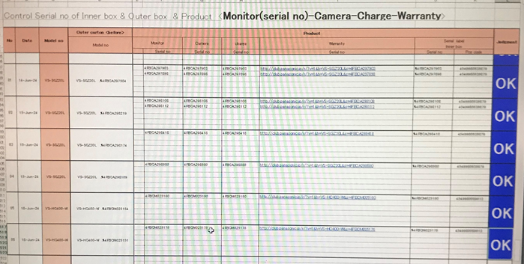
⑦ Reading barcode Product Inner to confirm correct serial No
10
Confirm ingredients of product for ensure matching Serial No
◆ Current
◆ Proposal
Reading barcode Product Inner to confirm correct S/N
Reading barcode Product Inner to confirm correct S/N
OQC make master list product ingredients: Monitor, camera, wireless, charger…
System can auto indicate ingredients must read barcode
This process is re-packing:
+ How to indicate set by set inspection result ?
NG or OK ? Any problem happen? What is next action ?
+ How this result link to total Judgment ?

Slide 14
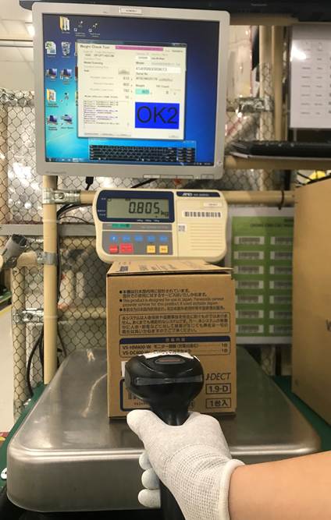

⑧ Weight check 2nd time
11
Current procedure from PCS → OQC → FA → SCM
◆ Current
◆ Proposal
Weight check 2nd time:
Purpose: To confirm full inner box after packing, compare weight check 1st time & 2nd time for judgment
Weight check 2nd time: Auto link with weight check system of FA to compare weight of inner box and Judgment
FA weight check system
Link
How can detect if FA weight check system have trouble ?

Slide 15
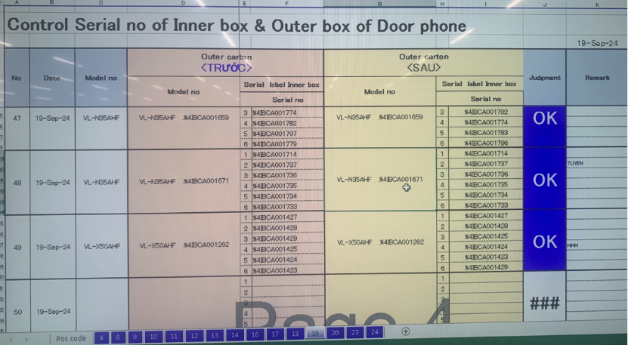

⑨ Reading barcode Inner/Outer 2nd time
12
Confirm matching Outer box with inner box
◆ Current
◆ Proposal
Reading barcode Outer & Inner 2nd time
Purpose: Ensure correct Outer box & Inner box
System auto link with FA weight check system
Scan ID outer → Auto link with FA weight check to compare Outer box & inner box
FA weight check system
Link

Slide 16
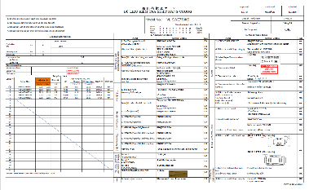
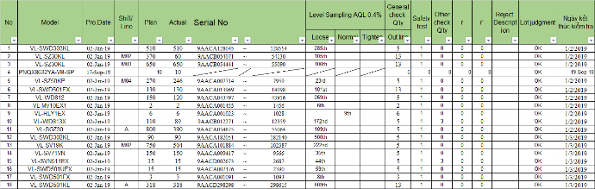
⑯ Output check sheet inspection & Report
13
Record OQC inspection check sheet and report
◆ Current
◆ Proposal
Current situation:
System auto output OQC inspection result
Manual making OQC inspection check sheet:
System auto output: Production Q’ty, Serial range, FA line, Production date, OQC sample serial No, Inspection date, Sample Q’ty
When reading barcode to start inspection : System link and open OQC check sheet. Then OQC check 1pc complete and indicate OK → Link to system for inspection result
Auto output inspection check sheet (Pdf) follow inspection date, lot
Manual input summary OQC inspection result:
➔ Using time: 10 mins/day
➔Save time: 10 mins/day

Slide 17
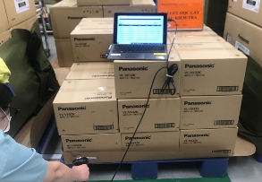
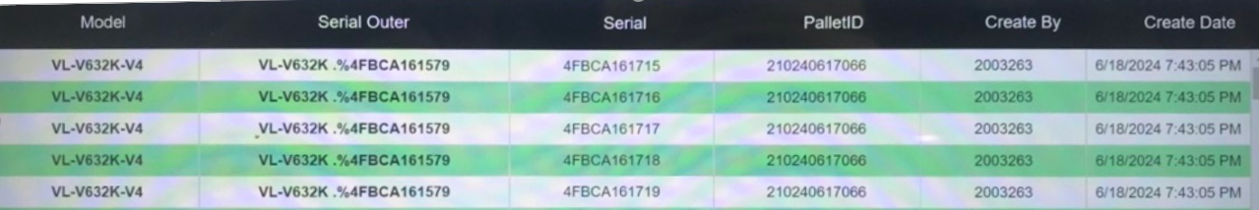
⑪~⑮ OQC chop stamp
14
Current chop stamp procedure
◆ Current
◆ Proposal
Current situation:
System auto indicate judgment lot
Finding pallet to confirm correct model, Q’ty
Indicate Judgment lot on system → All sections can understand lot situation
Eliminate physical chop stamp
How system link with ID pallet station or how to prevent production move to SCM without OQC approval: Using PDA to confirm Pallet situation, if OK → can transfer pallet
OQC find Pallet ID
Matching ID Pallet and Outer Carton
OQC chop stamp all ID Pallet
Read ID Pallet & S/N carton box by excel file
Find all same model, production date, line, shift
Chop stamp on Pallet sheet
OK
DD-MM-YY
OQC
2nd Floor: Đối với các pallet OQC đóng dấu thì FA sẽ kéo ra và để ở khu vực gần thang máy, nếu OK cả lô thì mới cho vào thang máy
1st Floor: Diện tích kho FA và SCM nhỏ
Using time:
DP/Dect: 480 mins/day
MW/TV/PJ/SB/PAPVN: 480mins/day
➔Save time: 960 mins/day ~ 2pax

Slide 18
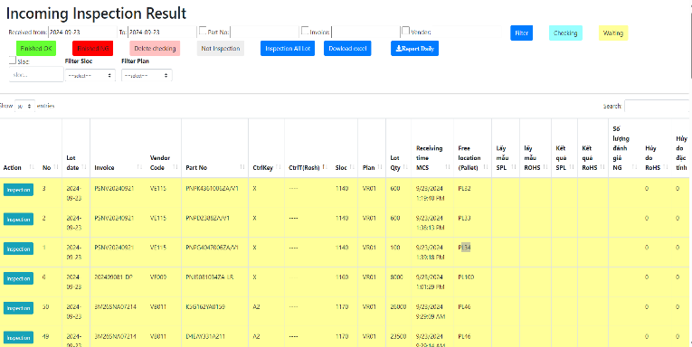
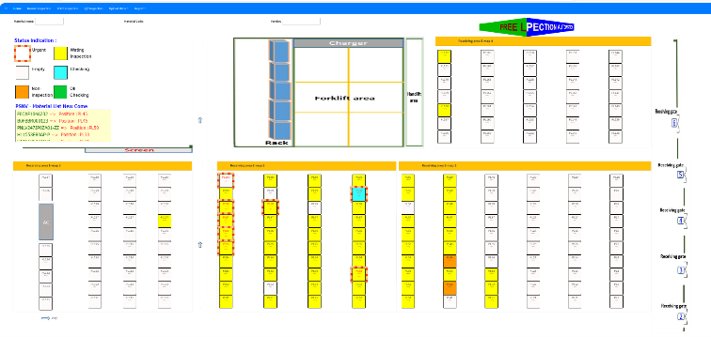
OQC DASH BOARD
15
Visualize status of OQC inspection situation
Indication location at warehouse
Status situation
Not checked yet
Checking
Checking
<Can move pallet>
OK
NG
1st Floor: How to control non-inspection pallet ?
Not checked yet : OQC not taken sample yet
Checking : Under OQC checking
Checking : Under OQC checking (Sample Q’ty already checked over a half Q’ty of all sample)
<Can move pallet>
OK : All Lot judgment OK
NG : Lot judged NG
OQC inspection indication
Location indication at warehouse

Slide 19


Preparation Equipment for system
16
Equipment list require
Section | Name Equipment | Image | Function | Quantity
OQC | Tablet windows (Connect with barcode reader) or PDA |  | 1.1, Pick up sample 1.2, Return Sample 1.3, Find quickly Pallet ID and Model at FA & SCM area 1.4, Visualize OQC inspection with FA, SCM | 3 (FA transfer)
FA | PDA |  | 2.1, Verify OQC judgment 2.2, Check the status of OQC inspection | 3 (FA consider)
ROI
Total Investment ($) | Efficiency/M ($) | Efficiency/Y ($) | ROI /Y
1,800 | 1,085 | 13,020 | 0.13824

Slide 20
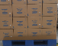


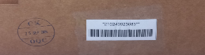
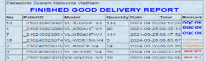
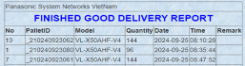
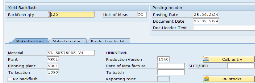

Change method transfer F/G to SCS
FA
17
BEFORE
AFTER
Current process
Improvement process
Production F/G OK
Production F/G OK
FA Make ID ID pallet
FA Make ID ID pallet
Waiting OQC check
Waiting OQC check
OQC stamping OK on slip sheet
OQC stamping OK on System
OQC OK
Manual check OQC OK
OQC OK
Check OQC OK by PDA
OQC OK
Download ID pallet scaned
LINK
Download ID pallet scaned
FA transfer SCS (SAP system)
Auto transfer
SCS (SAP system)
Print movement slip
Print movement slip
SCS Receive the finish goods Scan ID Pallet Code
FA transfer SCS (Actual)
FA transfer SCS (Actual)
Currently
Manual check OQC display OK
Manual transfer F/G to SCS (SAP system)
Printing hard movement slip: 3600pcs/monthly ⬄ 7.2Ream
Cost: 7.2*2.47$ = 17.78$/month ~ 213.4$/Year
Improvement
Check OQC OK by PDA
Auto transfer F/G to SCS (SAP system)
Abolish hard movement slip: 7.2Ream
Save Cost: 213.4$/Year
Reduced : 213.4 S/Y

Slide 21

OQC DIGITAL SYSTEM LINK WMS & CONFIRMATION DATA
SCM
18
SCS request:
Visualize status of model following shipment plan daily
Link final confirmation to WMS/PDA for operator working in warehouse
DASHBOARD
LINK WMS/PDA
Option 1
FA
OQC
SCS
WMS
①
Judgement auto email
FA transfer cargo to SCS
Shipment plan
Dashboard
Finish production
Sampling inspection
Shipment plan
*
Option 2
*
①
PSNV Portal
“Control shipping plan”
Pallet ID finish
Warning to dashboard
SCS visualize on pallet
②
Scan ID pallet
Result NG
FA/QC recheck
Judgement OK
Judgement OK
Scan ID pallet to receive
Result judged OK
Confirm data PDA
③
Email auto
Confirm receiving
Auto update
③
WMS
SCS check all data by download
**
Confirm receiving
**
Dashboard
Format check

Slide 22
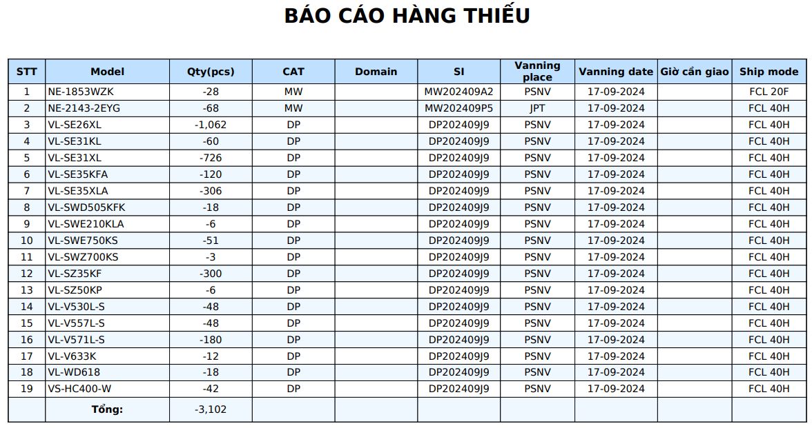
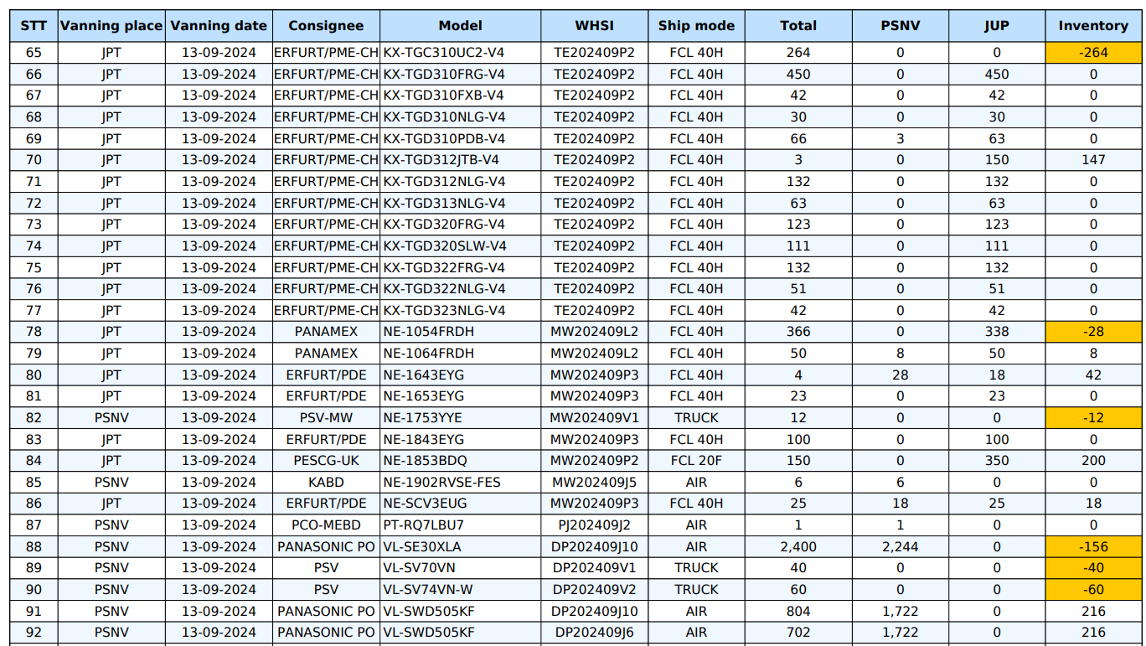
OQC DIGITAL SYSTEM LINK WMS & CONFIRMATION DATA
SCM
19
Details shortage shipment plan daily on WMS
Shortage shipment plan daily on WMS
FORMAT DOWNLOAD FROM DASHBOARD

Slide 23

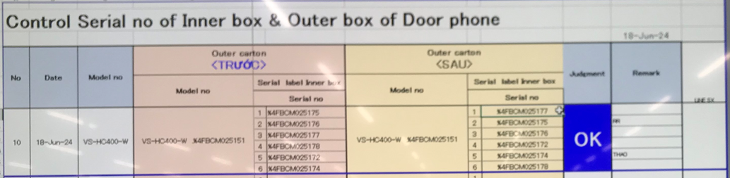



OQC Visualize System
2
Control process sample at OQC area
Pick up sample
Reading barcode Inner/Outer excel file
Weight check 1st
OQC
inspection
Reading BC
Product/Inner excel file
Weight check 2nd
Reading barcode
Inner/Outer excel file
Return sample
No Link
2
No Link
3
4
No Link
5
6
7
8
1
No Link
Reliability
No Link
No Link
No Link
Production Line
Confirm S/N Outer & all inner boxes
Accessory control
Numbering control & Separate area
Product / Warranty/ Manual & Inner box
Accessory control
Confirm S/N Outer & all inner boxes
Warehouse FA
OQC inspection result no link FA & SCM system, easy mistake.
All procedures are manual by Excel, loss time to traceability, and skip processes.
The results of the inspection process are manually stamped. Loss of time to stamp.
Improvement
Steps
1
2
3
4
5
6
7
8
Auto link weight FA
Auto link weight FA
Database server OQC
Control pick-up quantity

Slide 24
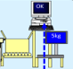



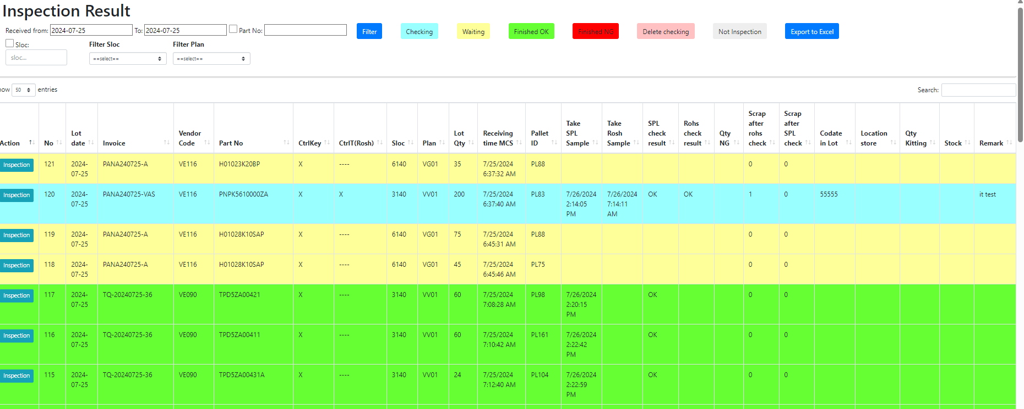

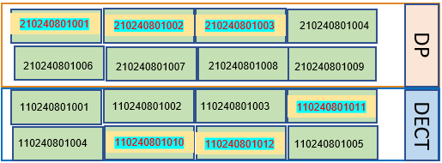

OQC Visualize System
4
E chop for OQC inspection
OQC inspection
OK
Steps
9
10
11
12
13
14
Day- Month- Year
OQC
Weight check
NG
OK
OQC member pick up sample
Auto judgment OK for
All pallet ID the same Model, production date, line and shift.
Use physical stamp
New system link FA-SCM-OQC
NG Location
Database server
FA
Link
OQC
Link
SCM
Visualize OQC inspection
DP area
E – chop can
replace
Shrink machine
OK
OQC return sample
FA shrink pallet ID
FA fix location
Day- Month- Year
OQC
Visualize FA Warehouse area
SCM Warehouse
SCM Out location
SCM area
DECT area
WMS system
Shipping To market

Slide 25
OQC Visualize System
4
Shipment to Market from SCM
c
FA
WMS
SCM warehouse
Combine F/G
Report S/N
(Export SI)
Shipment
OQC system
Function IT: SCM compare S/N, if 1 S/N not yet OK → Cannot shipment for all
Shipment to Market from Jupiter
c
Send email excel file to SCM: Pallet ID, Model, S/N
Function IT: SCM compare S/N, if 1 S/N not yet OK → Cannot shipment for all
OQC system
SCM warehouse
Jupiter
Shipment
Request:
IT : Auto indicate S/N OK or not
IT : Confirm with Hưng Đạo about Report S/N (SI)
IT : Add function of OQC for SCM

Slide 26
OQC Visualize System
4
Nội dung họp 20-Dec-24
Update thông tin của các nội dung họp lần trước (6-Dec-24)
Thảo luận về việc khi đánh giá all lot trong OQC thì cách nhận diện kết thúc lot trên FA
Thảo luận về báo cáo xuất hàng bên Hưng Đạo và cập nhật hàng thiếu hàng ngày

